Slide 1
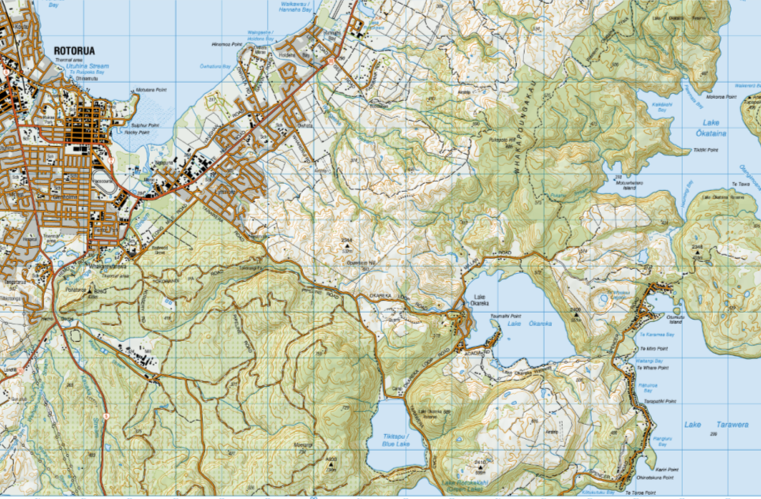
Lake Okareka
Lake
Tarawera
Discharge Path
Lake Okareka Location
Fig 1

Slide 2
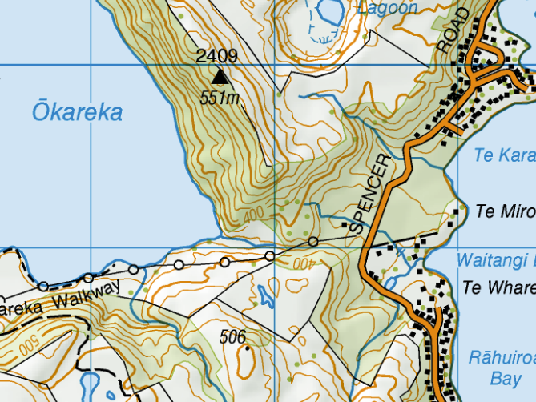
Lake Okareka Discharge to Lake Tarawera via Waitangi Stream
Fig 2

Slide 3
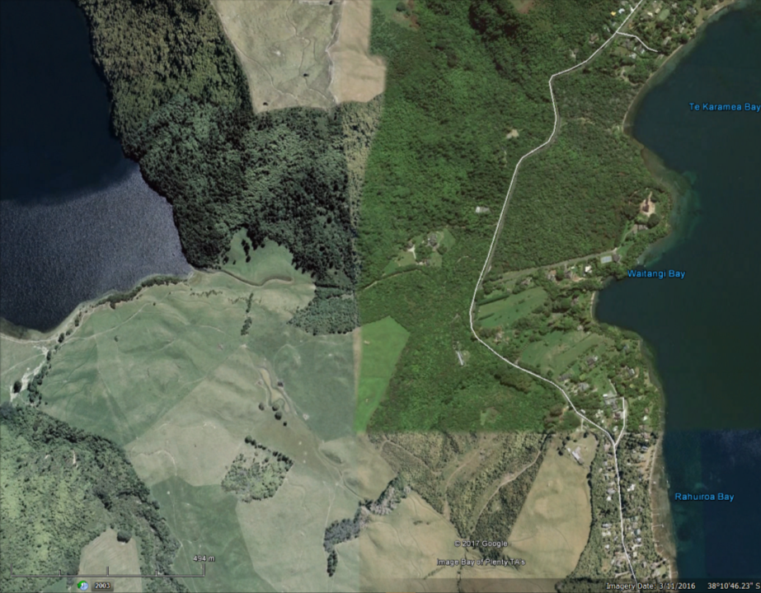
Lake Okareka
Lake Tarawera
Lake Okareka, Discharge Canal, Waitangi Stream and Lake Tarawera
Fig 3

Slide 4
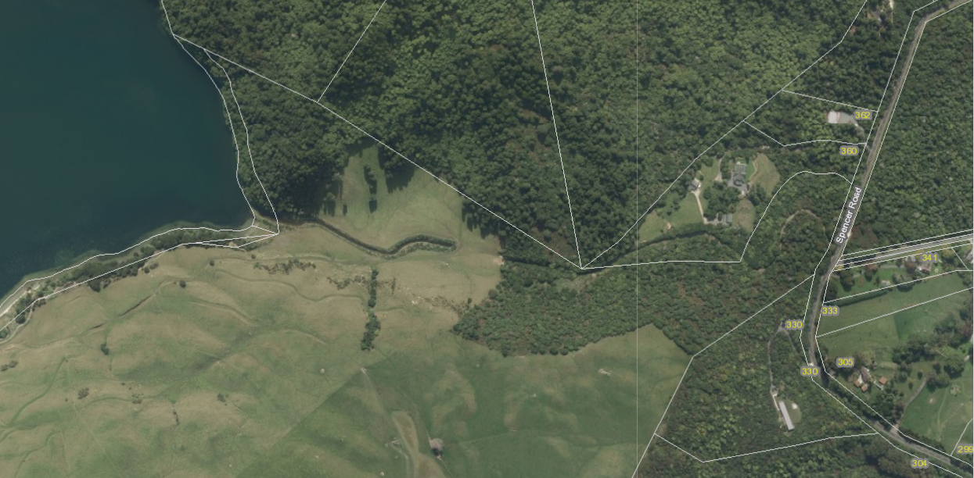
Lake Intake
Pipe Intake
Control Valve
Discharge Pt
Open Channel 300m
600mm
150m
450mm
167m
300mm
125m
Additional pipe placed alongside existing pipe
Discharge System
Fig 4

Slide 5
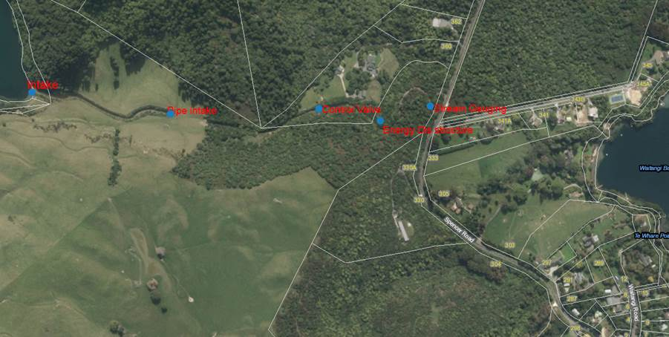
Canal
Control Valve
Stream gauging
Lake Outlet Pipes
Energy Dissipater
Pipe Intake
Spencer Road
Key Feature Locations NZTM Co-ordinates
1 Lake Outlet Pipes NZTM 1895725 5769066
2 Pipe Intake NZTM 1895994 5769027
3 Control Valve NZTM 1896276 5769036
4 Dissipater NZTM 1896398 5769012
Fig 5

Slide 6
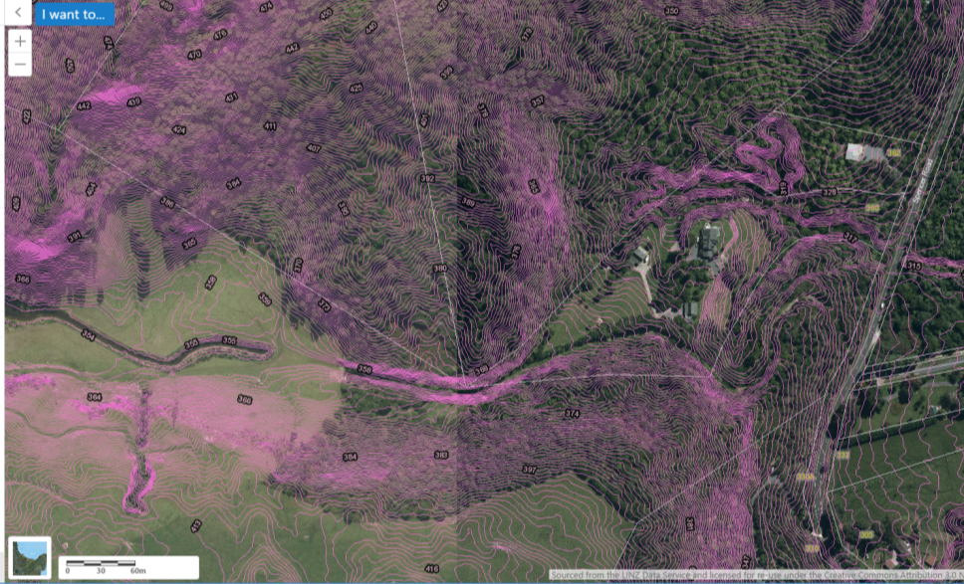
1
2
3
Open Water Channel
Piped Water
1 Intake
2 Control Valve
3 Energy Dissipater
Fig 6

Slide 7
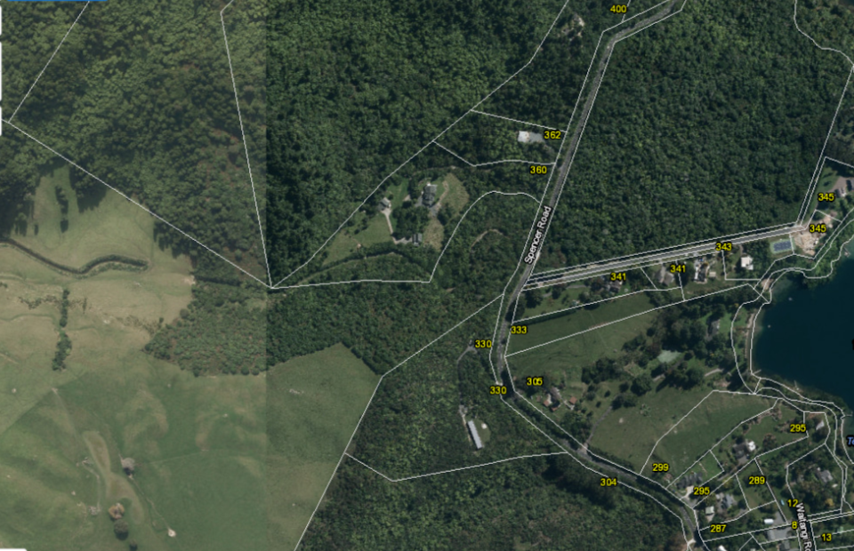
Ohorongo Block
Culverts
Gilmour
Murray
s
Green
Armstrong
Playne
Fig 7

Slide 8
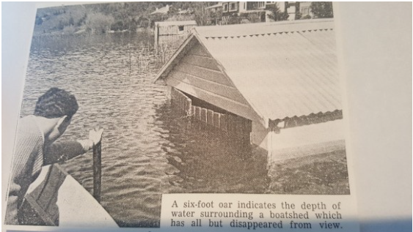
Fig 8

Slide 9
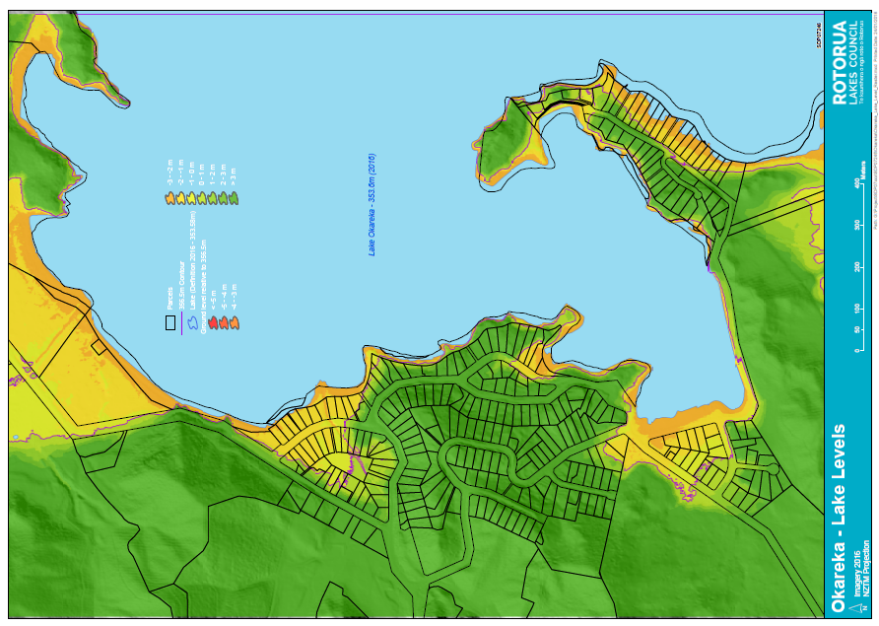
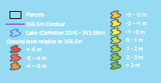
Fig 9
Red line shows the highest recorded lake level 356.4m in 1963

Slide 10
Fig 10

Slide 11
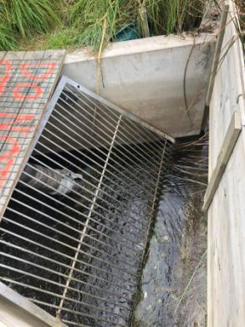
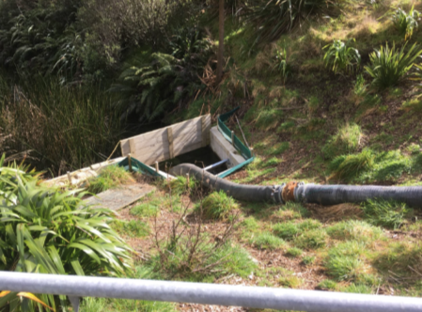
Fig 18 Pumped water take off downstream of the mesh screen and above the original discharge pipe
Fig 17 Mesh debris screen above culvert intake. Second pipe just visible
Fig 11

Slide 12
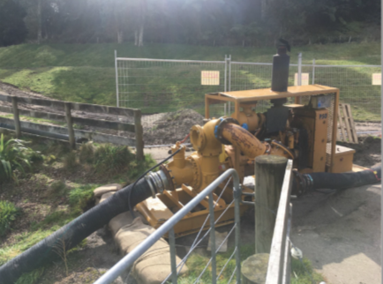
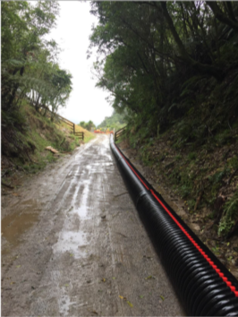
Pump - second pipe system
Additional second pipe on surface. The first pipe is below ground at this point
Fig 12

Slide 13
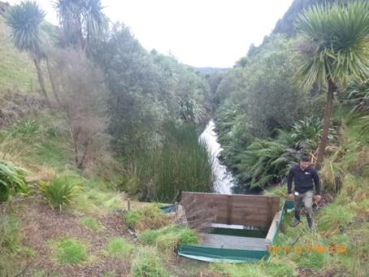
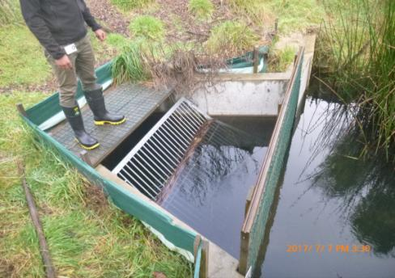
Intake Structure.
Fig 13

Slide 14
Fig 14

Slide 15
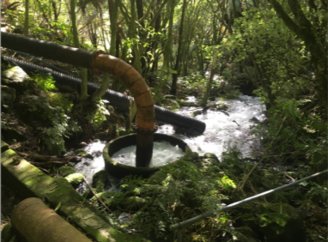
Dissipater – Discharge flowing into Waitangi Stream. Additional pipe placed to the rear, additional rip rap protection to reduce energy
Fig 15

Slide 16
Fig 16

Slide 17
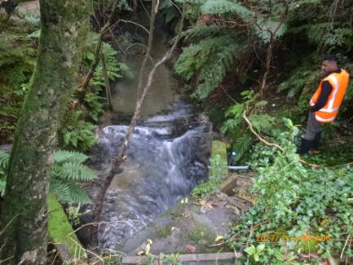
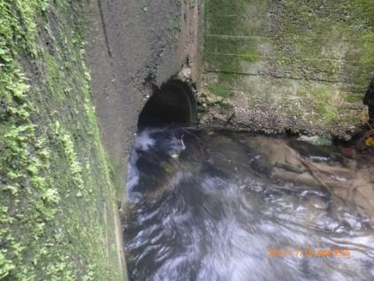
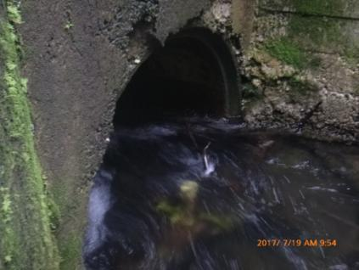
Spencer Road Culvert Flow 360L/s. Depth approximately 35% of capacity
Fig 17

Slide 18
*
* Decrease Rates Without Rainfall
Fig 18

Slide 19
Fig 19

Slide 20
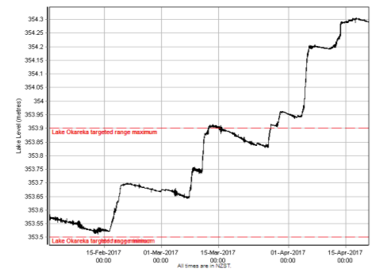
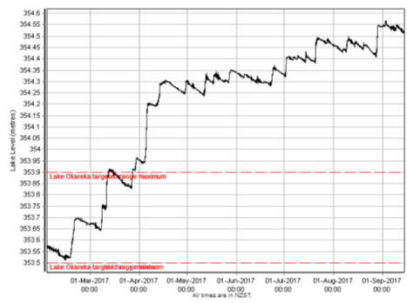
Lake Okareka Lake Levels – Low and High of 2017
Consent Target Range 353.5m – 353.9m
13 February 2017 Lake Level 353.531m (31mm above the target minimum, 361mm below target max)
13 March 2017 Lake Level 353.9m (At the target maximum)
17 April 2017 Lake Level 354.304m (404mm above target maximum)
3 September 2017 Lake Level 354.566m (666mm above target maximum)
Fig 20

Slide 21
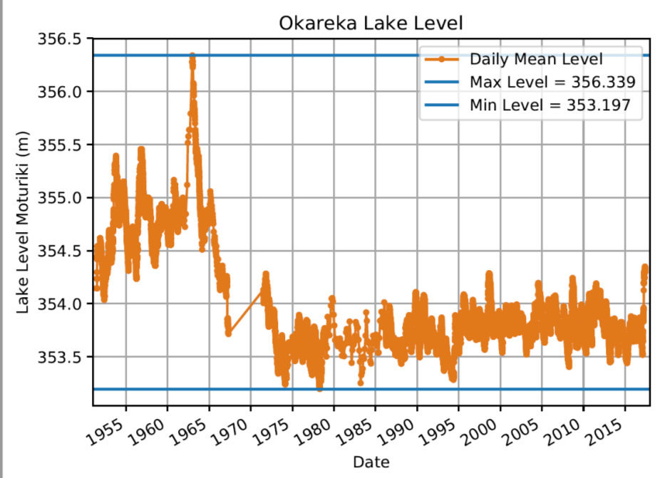
Historic High 1963
Recent Level – Highest since 1965
Historic Lake Levels 1955 -2017
Fig 21

Slide 22
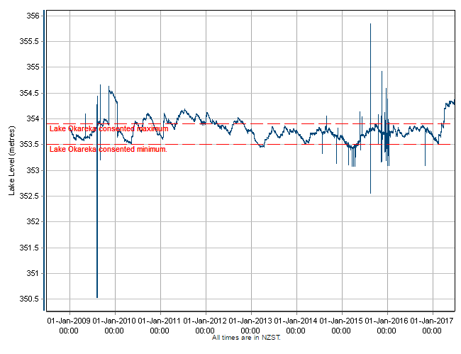
Live Monitoring Lake Level Records began 1 January 2009
Fig 22

Slide 23
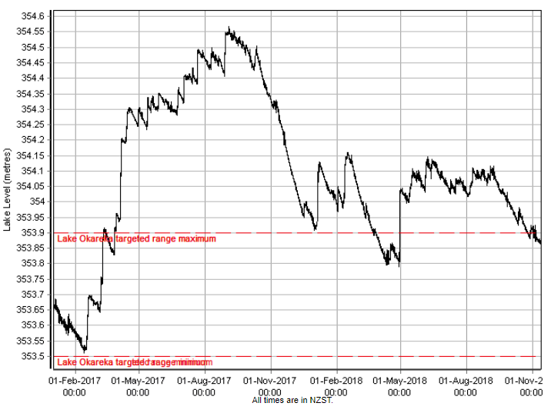
Maximum Lake Level 354.566m on 3 September 2017
Consent Target Range
Min 353.5m. Max 353.9m
Fig 23
Live Monitoring Lake Level from 1 January 2017 – 10 November 2018

Slide 24
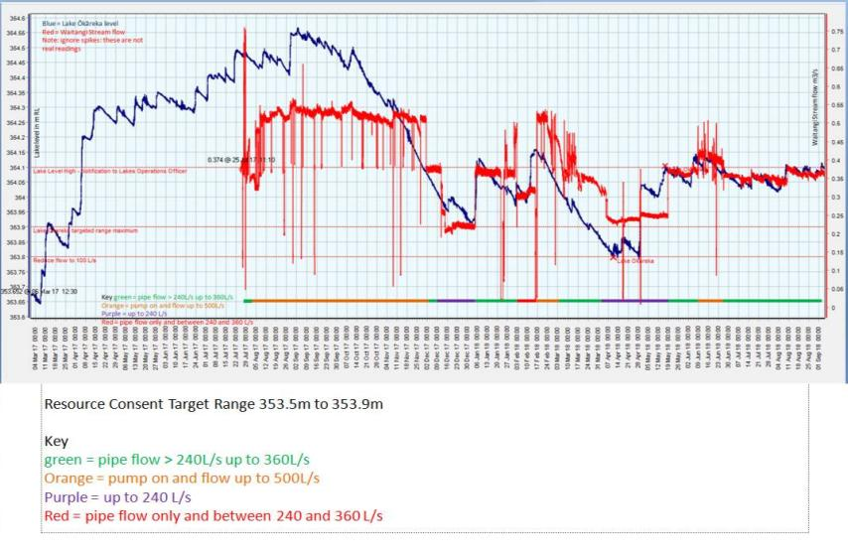
Max Flow 500L/s (Orange) 4 Aug 2017 to 17 Oct 2018
4 Aug to 2 Dec = 120 days
17 Feb to 3 March = 14 days
9 June to 25 June = 16 days
Total 150 days/399 = 38% of the time
Since the lake reached the consent target level (02/12/17) the pump has been used to discharge @ 500L/s for 30 days. 30/399 = 8%
From the end of the graph 01/09/18 to date 17/10/18 the discharge has been <300L/s.
Total discharge at 500L/s from 04/08/17 to 17/10/18 = 150/446 = 34% of the time
Total discharge at 500L/s from 02/12/17 to 17/10/18 = 30/446 = 7% of the time
Fig 24

Slide 25
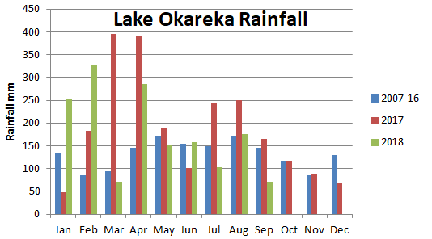
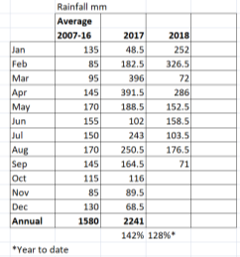
Rainfall Data from EDS Oct 2018
Monthly Rainfall Lake Okareka 2017 and 2018 compared to 2007-2016 Averages
Fig 25

Slide 26
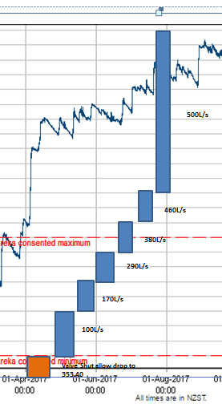
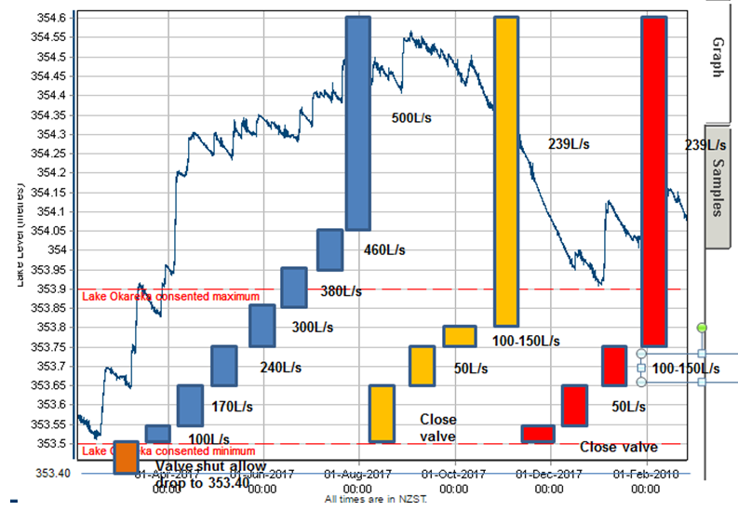
Fig 26

Slide 27
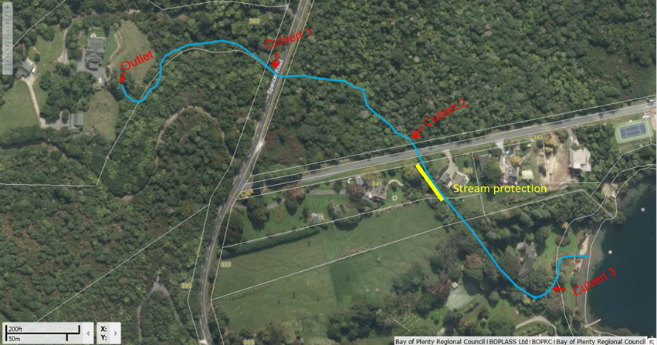
Fig 27

Slide 28
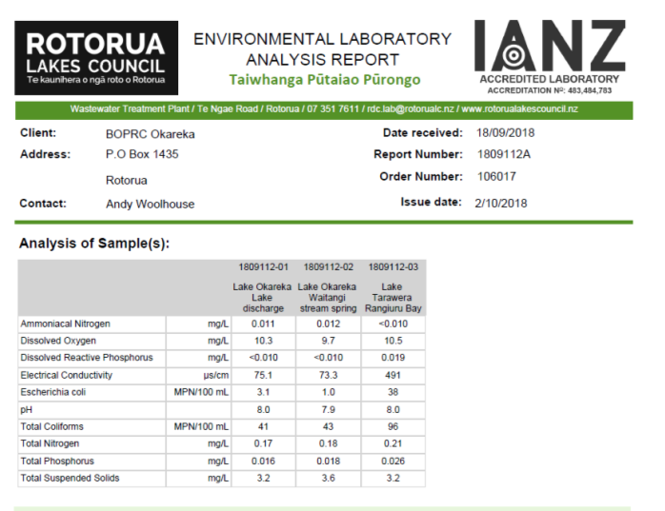
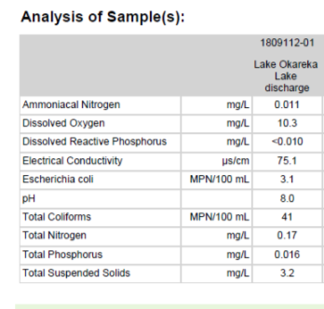
Fig 28

Slide 29
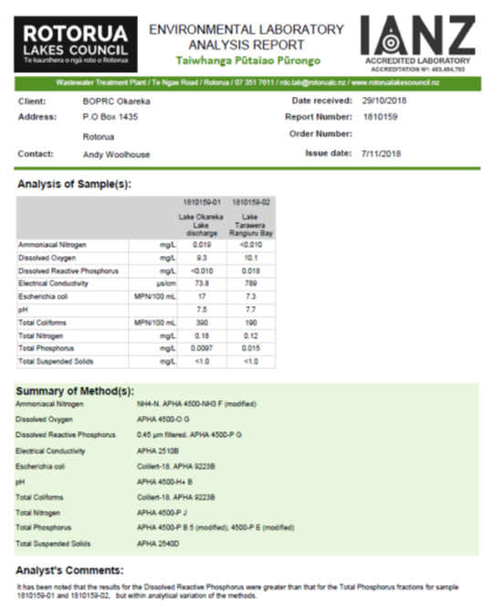
Sample Collected 28 October 2017 after rainfall event
Fig 29

Slide 30
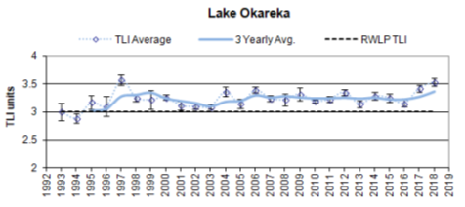
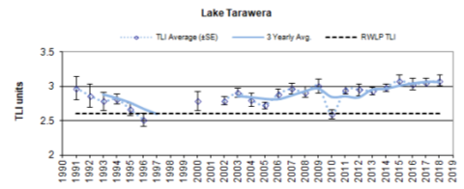
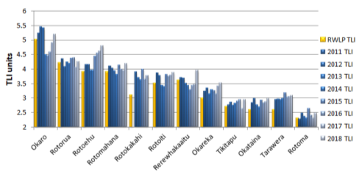
Lake Okareka annual average and three year average TLI Results
Lake Tarawera annual average and three year average TLI Results
Regional Natural Resources Plan TLI Objectives and annual TLI Results 2011 to 2018
Fig 30

Slide 31
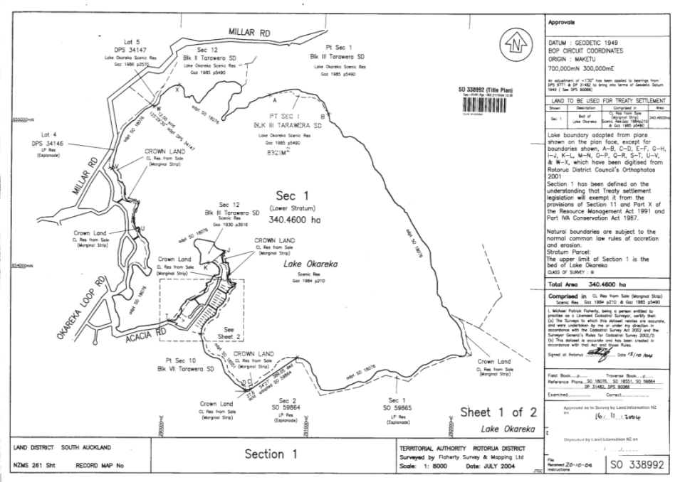
Statutory Acknowledgement to Te Arawa (Lakes). Okareka -Tuhourangi are affiliates
Fig 31

Slide 32
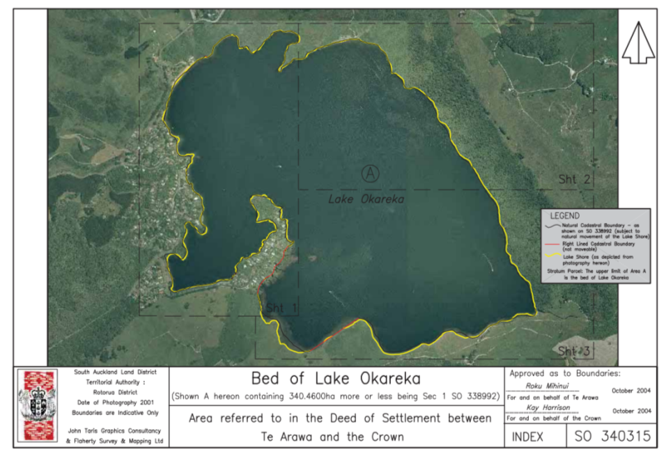
Statutory Acknowledgement to Te Arawa (Lakes). Okareka -Tuhourangi are affiliates
Fig 32

Slide 33
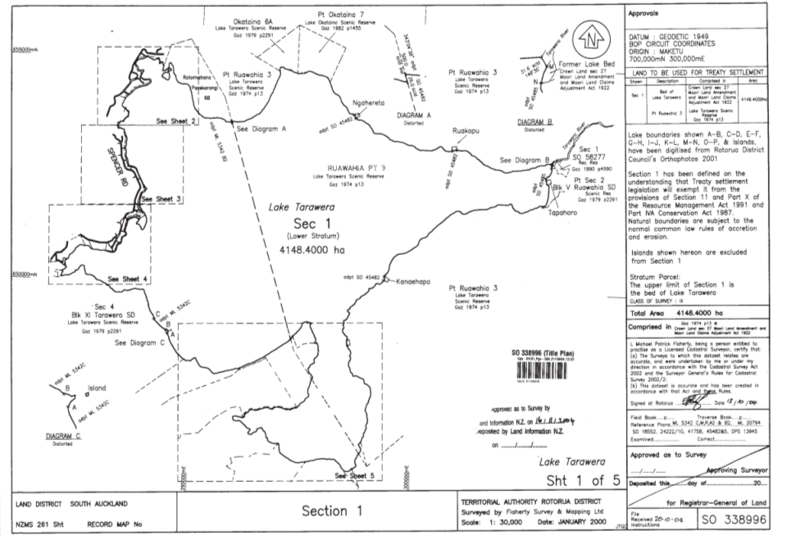
Statutory Acknowledgement to Te Arawa (Lakes). Tarawera
Fig 33

Slide 34
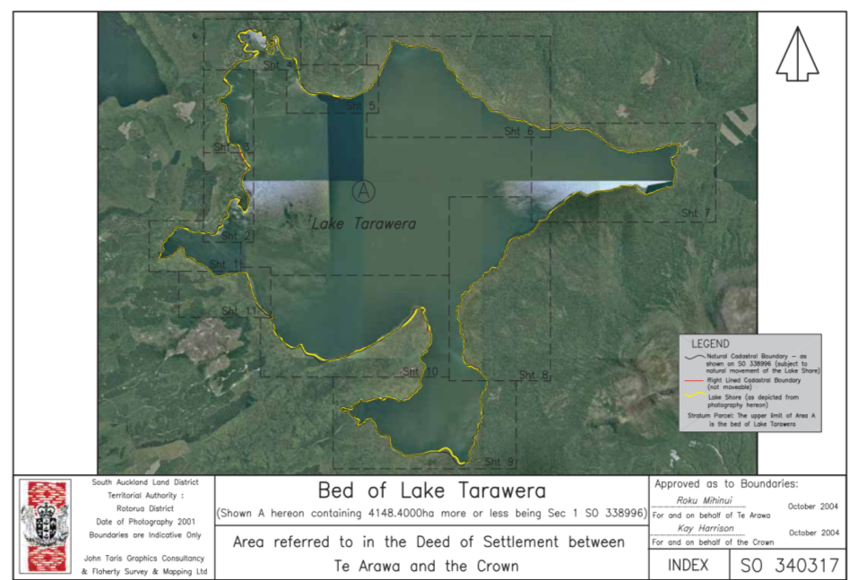
Fig 34
Statutory Acknowledgement to Te Arawa (Lakes). Tarawera

Slide 35
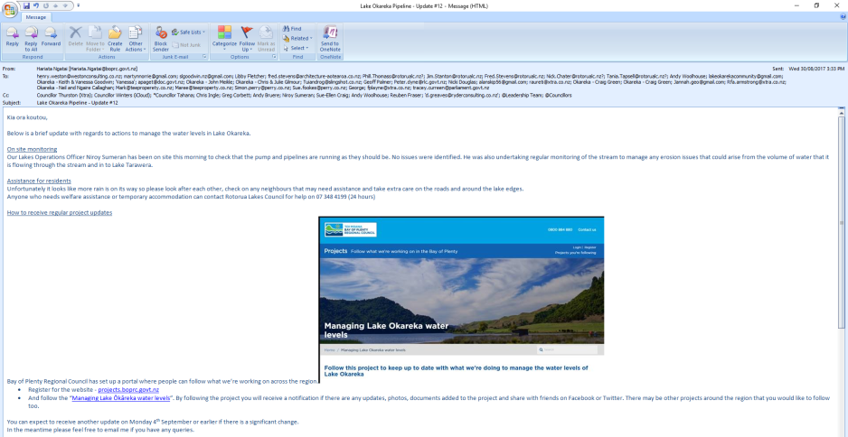
Lake Okareka Pipeline Update #12.
This is one of 25 updates provided in the period July 2017 to October 2018. It includes details of access to the website portal which contains all the updates, and extensive direct email list. There are also extracts and links on the Lake Okareka Community Association Newsletter
Fig 35

Slide 36
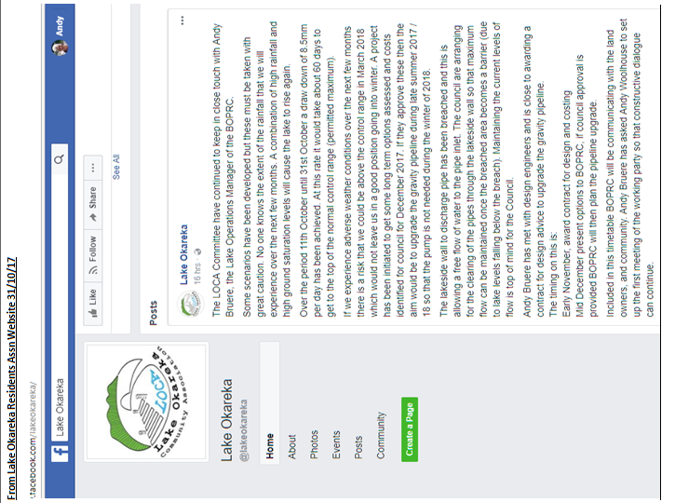
Fig 36

Slide 37
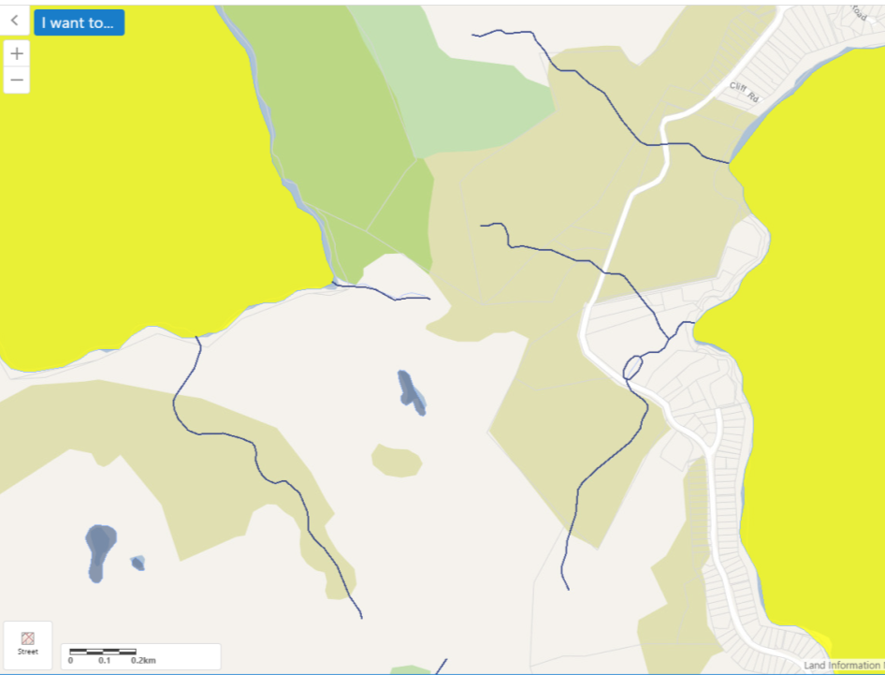
Fish Spawning Upper Tarawera River
Lake Okareka
Natural State lake
Lake Tarawera
Natural State Lake
Fig 37

Slide 38
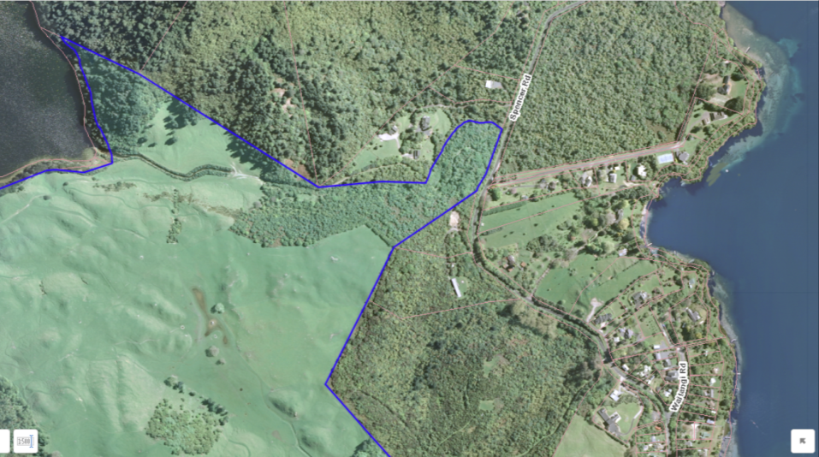
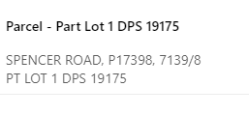
Title Details
Fig 38

Slide 39
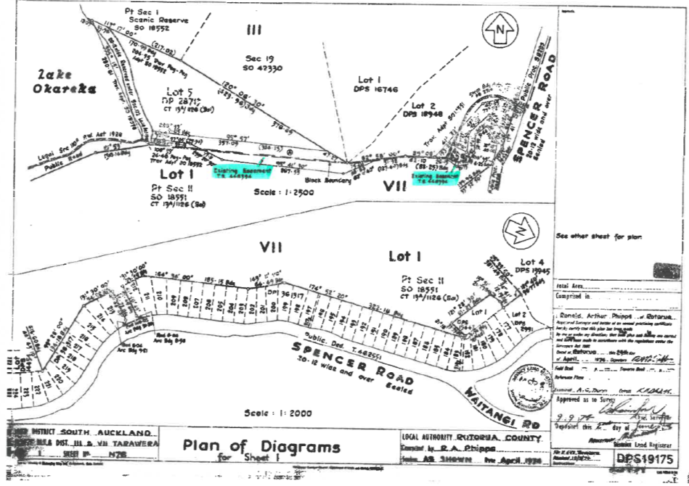
Easement 1
Fig 39

Slide 40
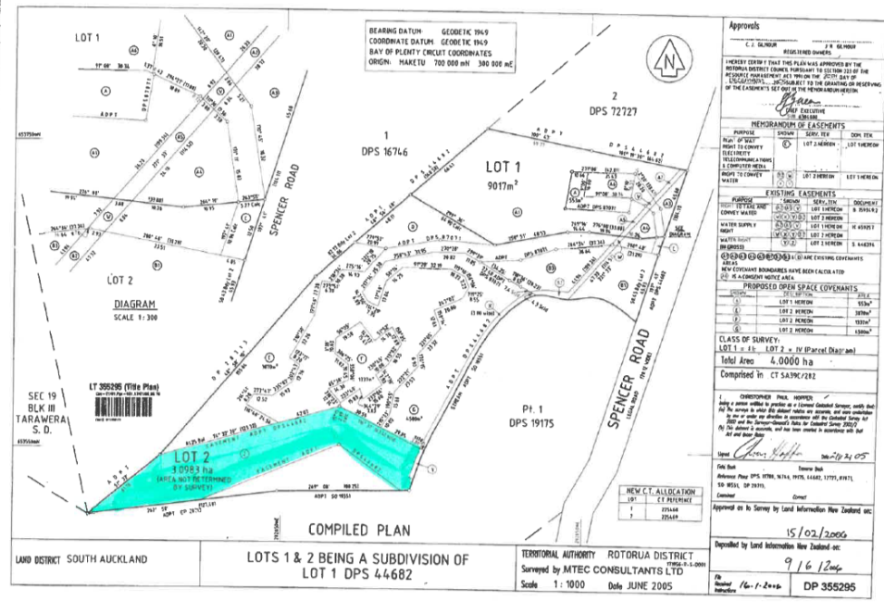
Easement 2
Fig 40

Slide 41
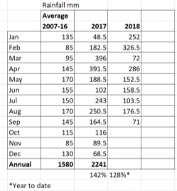
Rainfall Data from EDS Oct 2018
Fig 41

Slide 42
Lake Tarawera catchment including direct and indirect surface flows and groundwater flows
Lake Okareka Catchment
Lake Tarawera wider catchment 145kms²
Lake Okareka catchment 19kms²
Okareka make up approximately 12.9% of the wider Tarawera catchment
Ground and surface water flows into Lake Tarawera
From BOPRC Environmental Publication 2014/12 Tarawera Lakes Restoration Plan
Fig 42

