Slide 1
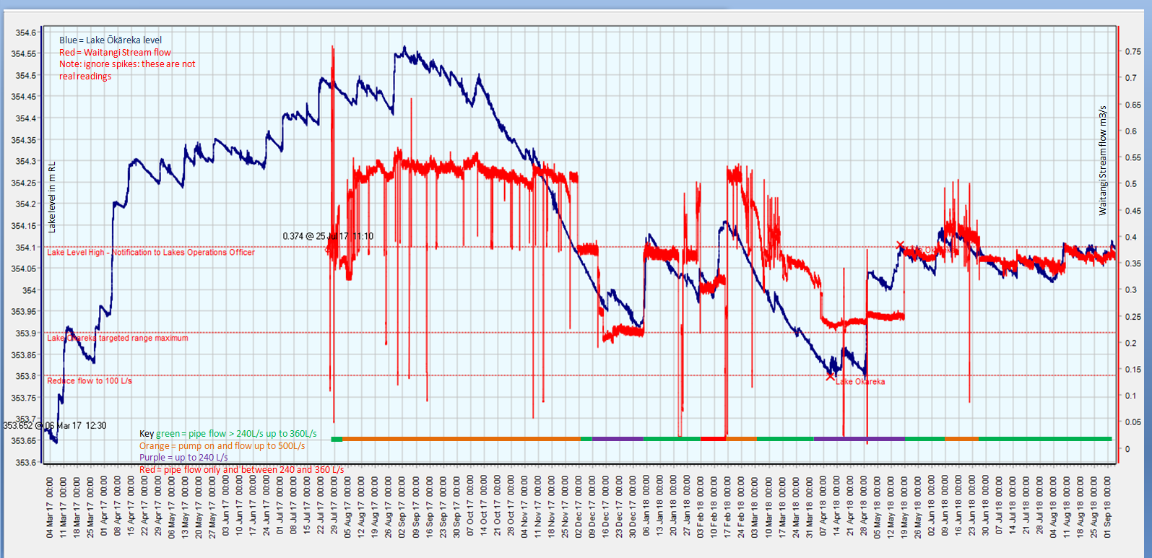
Key
green = pipe flow > 240L/s up to 360L/s
Orange = pump on and flow up to 500L/s
Purple = up to 240 L/s
Red = pipe flow only and between 240 and 360 L/s

Slide 2
The graph contains a bunch of data on Lake Ōkāreka level and flow down the Waitangi Stream. The blue line is lake level since Feb 2017. The red line is the flow down the Waitangi Stream since July 2017 when the recorder was installed. There are red dotted lines to indicate various target and warning levels. The lower target level does not feature on this graph as the lake has not been near the bottom of the range since Feb 2017. Over 2018 we have been able to keep the lake within about 200mm of the top of the consented target range. Along the bottom of the graph the coloured lines show the times when we have run at various flow options: consented flow of 240L/s, up to maximum pipe flow of 240 to 360 L/s and additional flow using the pump up to 500 L/s. Note also that the flow data has some data spikes. These are not real measurements but just spikes on the recorder. They should be ignored and just look at the steady recodings.

